Slide 1
LCD Interface

Slide 2
https://stackoverflow.com/questions/29315028/working-with-32-bit-data-types-and-8-bit-data-type-in-arm
http://www.firmcodes.com/microcontrollers/arm/interfacing-lcd-armlpc21xx-4-bit-mode/
https://circuitdigest.com/microcontroller-projects/interfacing-16x2-lcd-with-arm7-lpc-2148-in-4-bit-mode
https://armprocessorforu.files.wordpress.com/2014/12/1-4_bit_lcd_interfacing_with_arm7_primer.pdf
https://www.engineersgarage.com/lcd-in-4-bit-mode-and-8-bit-mode/

Slide 3
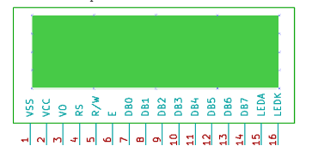
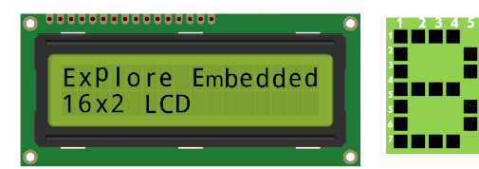
Pin Number | Symbol | Pin Function
1 | VSS | Ground
2 | VCC | +5v
3 | VEE | Contrast adjustment (VO)
4 | RS | Register Select. 0:Command, 1: Data
5 | R/W | Read/Write, R/W=0: Write & R/W=1: Read
6 | EN | Enable. Falling edge triggered
7 | D0 | Data Bit 0
8 | D1 | Data Bit 1
9 | D2 | Data Bit 2
10 | D3 | Data Bit 3)
11 | D4 | Data Bit 4
12 | D5 | Data Bit 5
13 | D6 | Data Bit 6
14 | D7 | Data Bit 7/Busy Flag
15 | A/LED+ | Back-light Anode(+)
16 | K/LED- | Back-Light Cathode(-)

Slide 4
Data Bus: As shown in the above figure and table, an alphanumeric LCD has an 8-bit data bus referenced as D0-D7. As it is an 8-bit data bus, we can send the data/cmd to LCD in bytes. It also provides the provision to send the data/cmd in chunks of 4-bit, which is used when there are limited number of GPIO lines on the microcontroller. Register Select(RS): The LCD has two register namely a Data register and Command register. Any data that needs to be displayed on the LCD has to be written to the data register of LCD. Command can be issued to LCD by writing it to Command register of LCD. This signal is used to differentiate the data/cmd received by the LCD. If the RS signal is LOW then the LCD interprets the 8-bit info as Command and writes it Command register and performs the action as per the command. If the RS signal is HIGH then the LCD interprets the 8-bit info as data and copies it to data register. After that the LCD decodes the data for generating the 5x7 pattern and finally displays on the LCD. Read/Write(RW): This signal is used to write the data/cmd to LCD and reads the busy flag of LCD. For write operation the RW should be LOW and for read operation the R/W should be HIGH. Enable(EN): This pin is used to send the enable trigger to LCD. After sending the data/cmd, Selecting the data/cmd register, Selecting the Write operation. An HIGH-to-LOW pulse has to be sent on this enable pin which will latch the info into the LCD register and triggers the LCD to act accordingly.

Slide 5
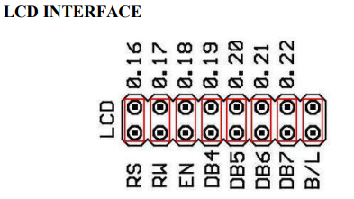

Slide 6
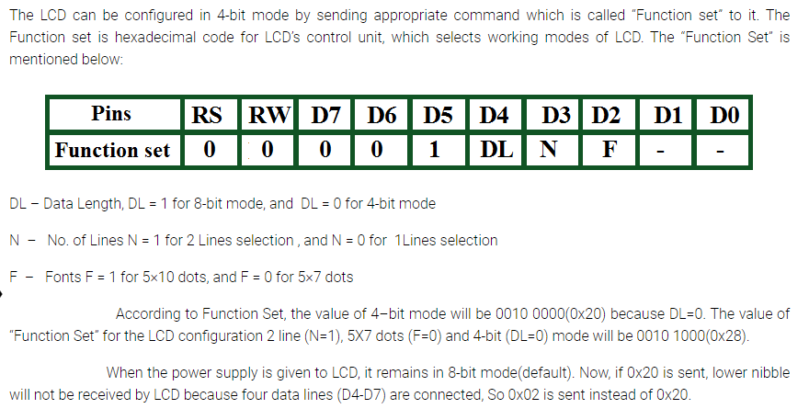

Slide 7
